Slide 1
Track & Field Meet Server
Phase 3 Presentation
Tracy Marshall

Slide 2
Agenda
Action Items
Component Design
Assessment Evaluation
Project Evaluation
Future Work
Demonstration
Questions and Comments

Slide 3
Action Items
Update Technical Inspection Checklist
Make updates based on Technical Inspection feedback

Slide 4
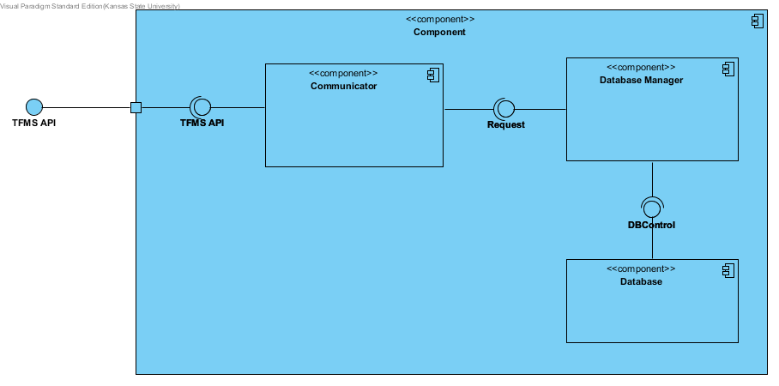
Component Design

Slide 5
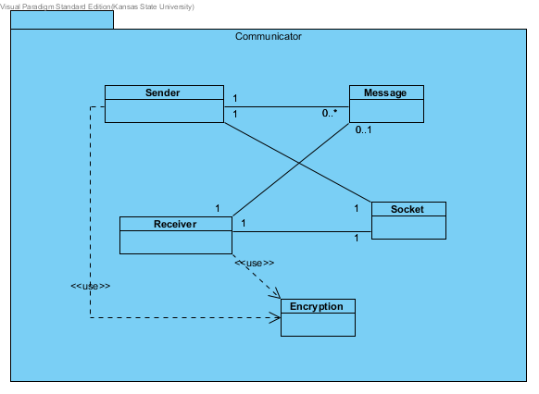
Component Design

Slide 6
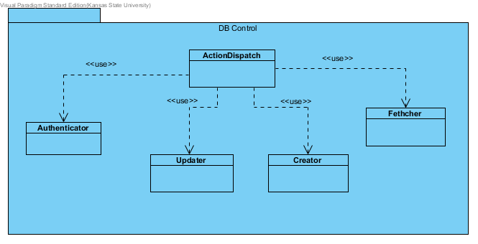
Component Design

Slide 7
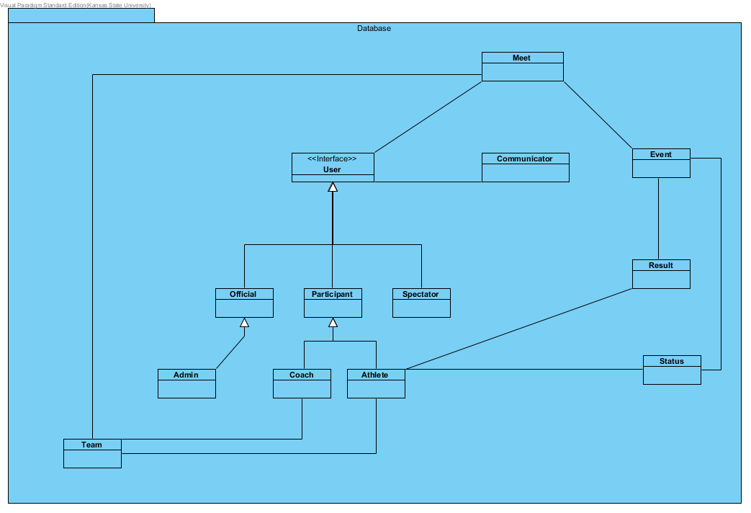
Component Design

Slide 8
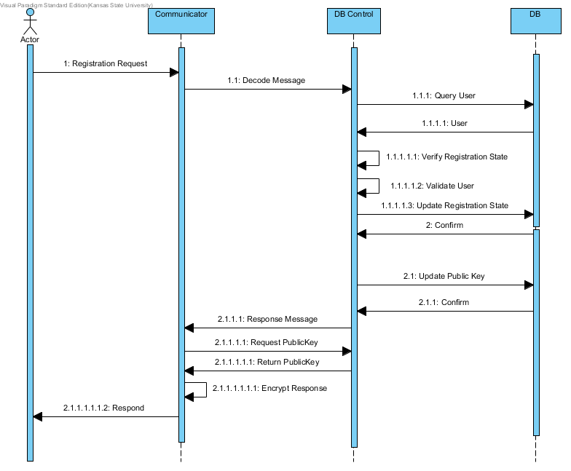
Component Design

Slide 9
Assessment Evaluation
# | Scenario | Results
1 | Adding data as an admin | PASS
2 | Modify data in the server | PASS
3 | Submitting data as an official | PASS
4 | Reporting Status | PASS
5 | User Authentication | PASS

Slide 10
Project Evaluation
Source Lines of Code
Project Duration
Phase | SLOC Estimate
Phase 1 | 100
Phase 2 | 275
Phase 3 | 325
Phase | Start Date | End Date
Phase 1 | 6/6/16 | 7/29/16
Phase 2 | 8/22/16 | 10/24/16
Phase 3 | 10/24/16 | 12/12/16

Slide 11
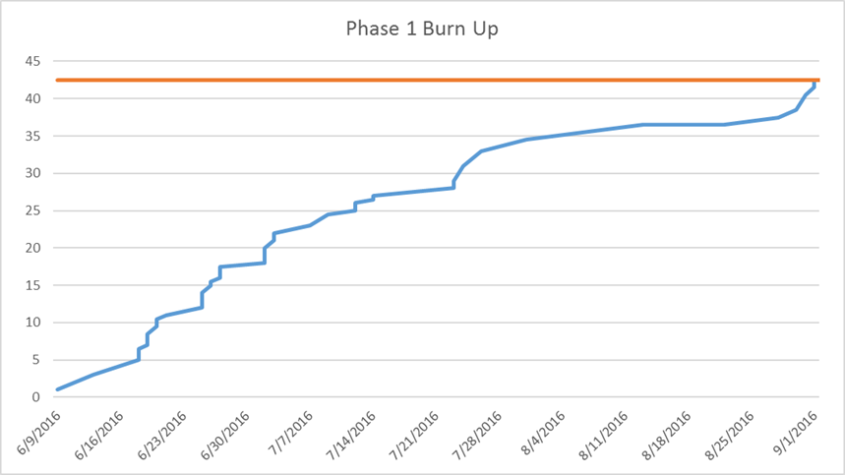
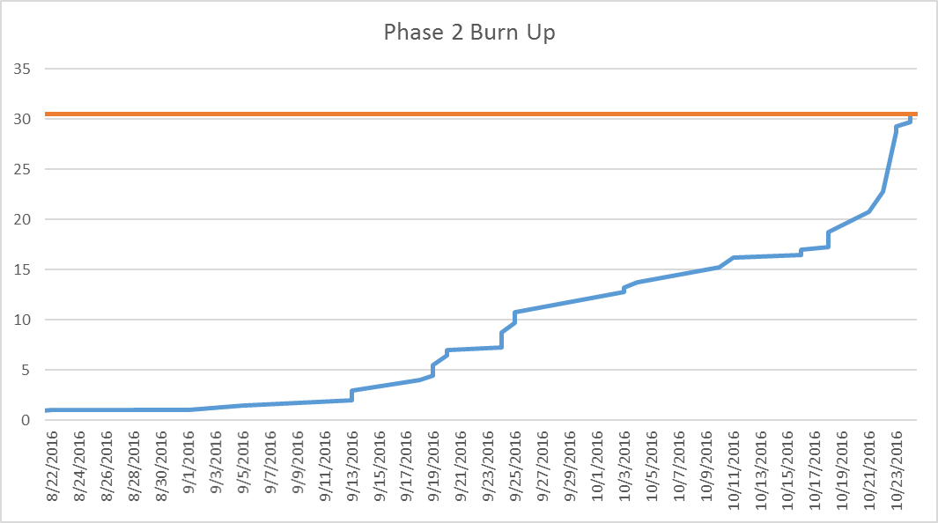
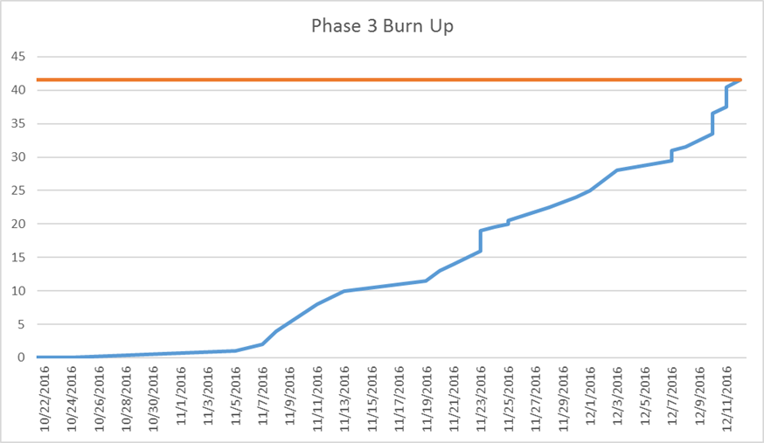
Project Evaluation

Slide 12
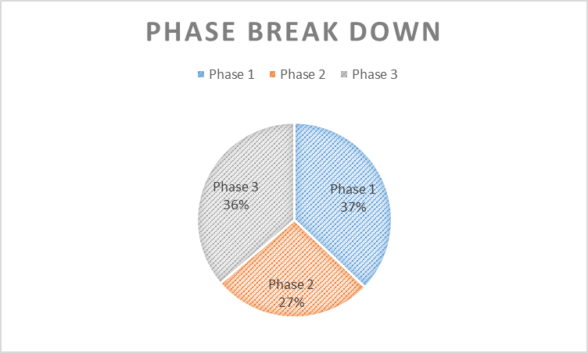
Project Evaluation

Slide 13
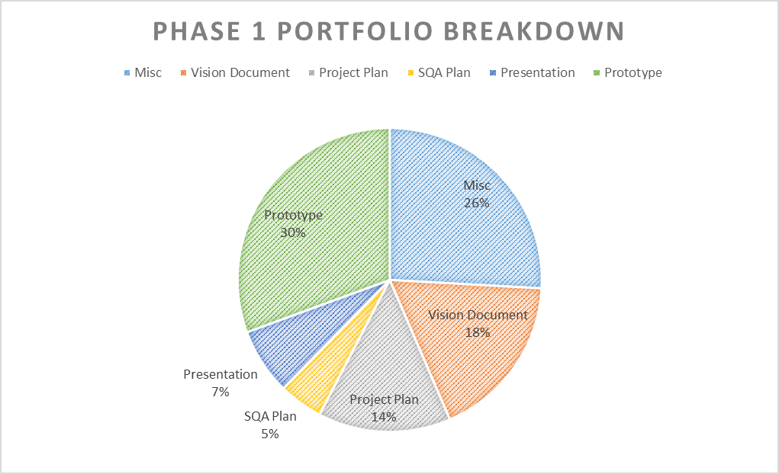
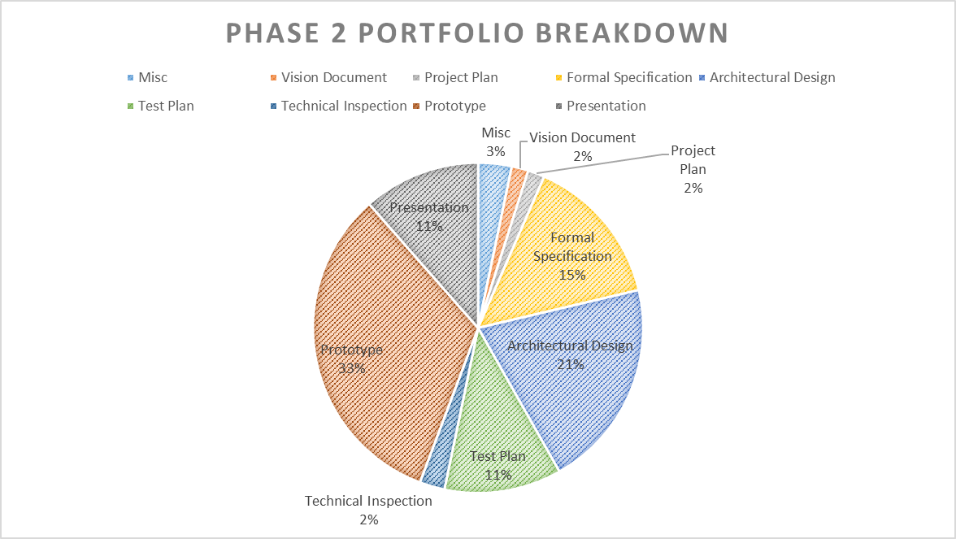
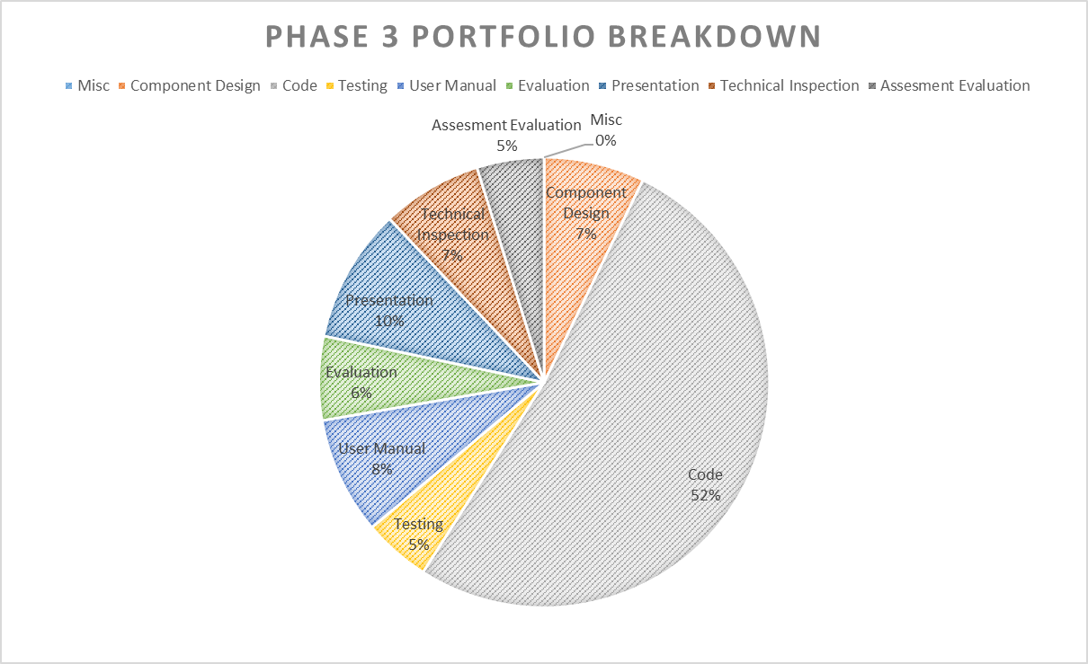
Project Evaluation

Slide 14
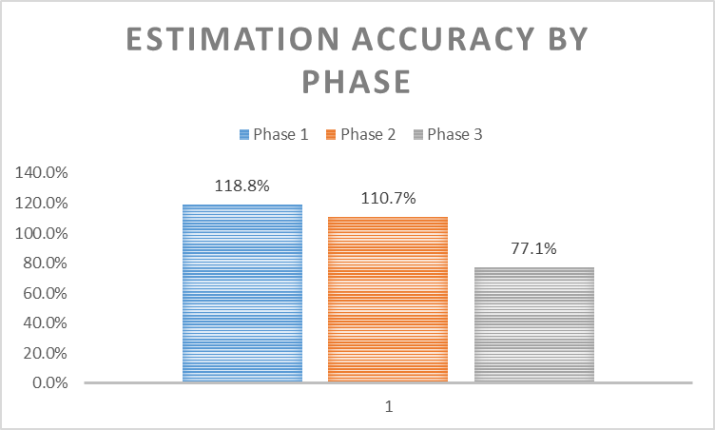
Project Evaluation

Slide 15
Project Evaluation
Lessons Learned
Cryptography and Security
Server Implementation
Programming Language

Slide 16
Future Work
Build Up Framework
Work On Security
Dry Run

Slide 17
Deomonstration

Slide 18
Questions and Comments

